Slide 1
Minimum Spanning Tree

Slide 2
Definition: M.S.T.
A minimum-cost spanning tree is a spanning tree of least cost
The cost of a MST is the sum of the weights of the edges in the spanning tree
Greedy Algorithms for finding the M.S.T.
Kruskal’s algorithm
Prim’s algorithm
Sollin’s algorithm
Notes:
2

Slide 3
Constraints for M.S.T.
Constrains for the min-cost spanning trees
Must use only edges within the graph.
Must use exactly n - 1 edges.
May not use edges that produce a cycle
Greedy Strategy
Construct an optimal solution in stages
Make the best decision (selection) at each stage
using least-cost criterion
The decision must result in a feasible solution
a feasible solution works within the constraints specified by the problem
Notes:
3

Slide 4
Kruskal’s Algorithm
Kruskal’s Algorithm
Adding edges to MST T one edge at a time
Selected edges are in non-decreasing order of the cost
An edge is added to T if it does not form a cycle
Since G is connected and has n > 0 vertices, exactly n-1 edges will be selected
Time complexity: O(e log e)
Notes:
4

Slide 5
Implementation: Kruskal’s Algo.
T = {};
While (T contains less than n-1 edges && E is not empty){
choose a least cost edge (v,w) from E;
delete (v,w) from F;
if ((v,w) does not create a cycle in T)
add (v,w) to T;
else
discard (v,w);
}
If (T contains fewer than n-1 edges)
printf (“No spanning tree\n”);
0
28
10
1
14
16
5
6
2
24
25
✗
18
12
4
✗
O(e log e)
Edge ordering: priority queue/min heaps
Checking for cycle
choose
22
3
Notes:
5

Slide 6
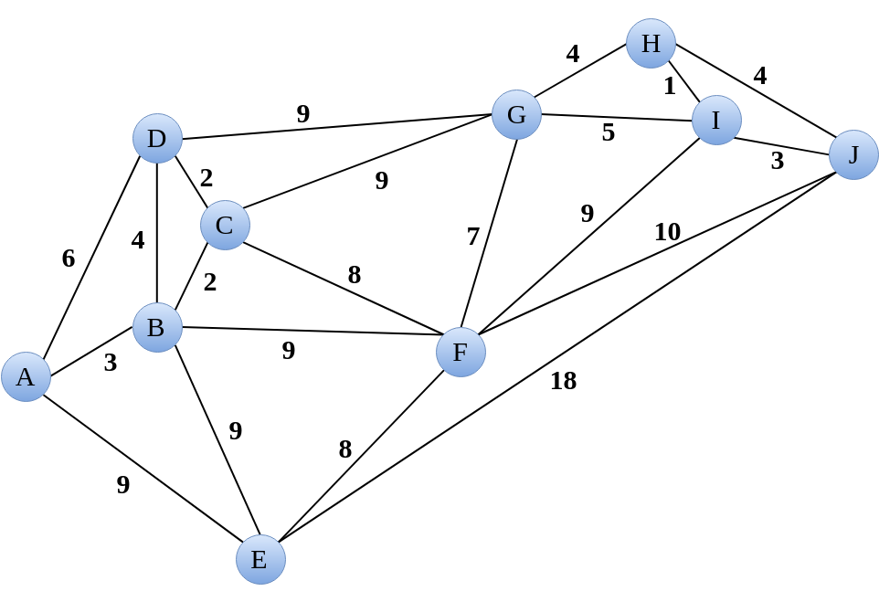
Practice Time
Find the minimum cost spanning tree by Kruskal’s Algo.

Slide 7
Prim’s Algorithm
Prim’s Algorithm
Build a minimum cost spanning tree T by adding edges to T one at a time.
At each stage, add a least cost edge to T such that the set of selected edges is still a tree.
Repeat the edge addition step until T contains n-1 edges.
Notes:
7

Slide 8
Implementation: Prim’s Algo.
T = {};
TV = {0}; /* start with vertex 0 and no edges */
While (T contains fewer than n-1 edges) {
let (u,v) be a least cost edge such that u TV and
v TV;
if (there is no such edge
break;
add v to TV;
add (u,v) to T;
}
If (T contains fewer than n-1 edges)
printf (“No spanning tree\n”);
0
28
10
1
14
16
5
6
2
24
25
18
12
4
22
3
Notes:
8

Slide 9
Practice Time
Find the minimum cost spanning tree by Prim’s Algo.

Slide 10
Sollin’s Algorithm
Sollin’s Algorithm
Selects several edges for inclusion in T at each stage
At the start of a stage, each vertex form a spanning tree
During a stage, select a minimum cost edge that has exactly one vertex in the tree for each tree
Repeat until only one tree at the end of a stage or no edges remain for selection
Stage 1: (0, 5), (1, 6), (2, 3), (3, 2), (4, 3), (5, 0), (6, 1)
⇨{(0, 5)}, {(1, 6)}, {(2, 3), (4, 3)}
Stage 2: {(0, 5), (5, 4)}, {(1, 6), (1, 2)}, {(2, 3), (4, 3), (1, 2)}
Result: {(0, 5), (5, 4), (1, 6), (1, 2), (2, 3), (4, 3)}
0
28
10
1
14
16
5
6
2
24
25
18
12
4
22
3
Notes:
10

Slide 11
Practice Time
Find the minimum cost spanning tree by Sollin’s Algo.

Slide 12
Shortest Paths

Slide 13

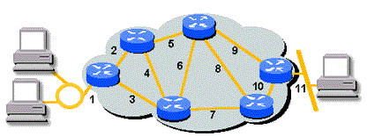
Shortest Path Problems
Is there a path from city A to city B?
If there is more than one path from A to B, which path is the shortest?
Notes:
13

Slide 14
Single Source/All Destinations
Problem: given a directed graph G = (V, E)
a length function length(i, j), length(i, j) ≥ 0, for the edges of G (nonnegative edge cost)
and a source vertex v
Find: a shortest path from v to each of the remaining vertices of G.
dist[w]:
the length of shortest path starting from v and ending at w
going through only vertices in S, S is a subset of V(G)
45
50 10
V₀
V₁
V₄
20 10 15 20 35 30
15 3
V₂
V₃
V₅
path length
1) v₀ v₂ 10
2) v₀ v₂ v₃ 25
3) v₀ v₂ v₃ v₁ 45
4) v₀ v₄ 45
Notes:
14

Slide 15
Dijkstra’s Algorithm
Find the min cost of the path from a given source node to every other node.
if v_{i} and v_{j} are not adjacent, then e(v_{i}, v_{j}) = ∞
O(n²)
S = {v0};
dist[v0] = 0;
for each v in V - {v0} do dist[v] = e(v0, v);
while S ≠ V do
choose a vertex w in V-S such that dist[w] is a minimum;
add w to S;
for each v in V-S do
dist[v] = min(dist[v], dist[w]+e(w, v));
Notes:
15

Slide 16
Dijkstra: Adj. Matrix Declaration
Declarations for the Shortest Path Algorithm
#define MAX_VERTICES 6
int cost[ ][MAX_VERTICES]=
{ { 0, 50, 10, 1000, 45, 1000},
{1000, 0, 15, 1000, 10, 1000},
{ 20, 1000, 0, 15, 1000, 1000},
{1000, 20, 1000, 0, 35, 1000},
{1000, 1000, 30, 1000, 0, 1000},
{1000, 1000, 1000, 3, 1000, 0}};
45
int distance[MAX_VERTICES];
short int found{MAX_VERTICES];
int n = MAX_VERTICES;
50 10
V₀
V₁
V₄
20 10 15 20 35 30
V₂
15 3
V₃
V₅
Notes:
16

Slide 17
Dijkstra: Single Source (v₀) Shortest Paths
void shortestpath (int v, int cost[][MAX_VERTICES],
int distance[], int n, short int found[])
{
int i, u, w;
for (i=0; i<n; i++) {
found[i] = FALSE;
distance[i] = cost[v][i];
}
found[v] = TRUE;
distance[v] = 0;
for(i=0; i<n-2; i++) {
u =choose(distance,n,found);
found[u] = TRUE;
for(w=0; w<n; w++)
if (!found[w]) /* compute the distance by u
if (distance[u]+cost[u][w]<distance[w])
distance[w] = distance[u]+cost[u][w];
}
}
[0]
[1]
[2]
[3]
[4]
[5]
found:
cost:
45
V₀
50 10
V₁
V₄
20 10 15 20 35 30
V₂
15 3
V₃
V₅
0
45
50
25
1000
45
10
25
10
45
distance:
45
1000
i:
1
2
3
0
u:
2
3
1
4
w:
0
1
2
3
4
5
Notes:
17

Slide 18
Dijkstra: Least Cost Edge
found:
[0]
[1]
[2]
[3]
[4]
[5]
distance:
0
50
10
1000
45
1000
int choose (int distance[], int n, short in found[])
{ /* find the smallest distance not yet checked */
int I, min, minpos;
min = INT_MAX;
minpos = -1;
for (i=0; i<n; i++)
if (distance[i] < min && !found[i]) {
min = distance[i];
minpos = i;
}
return minpos;
}
Notes:
18

Slide 19
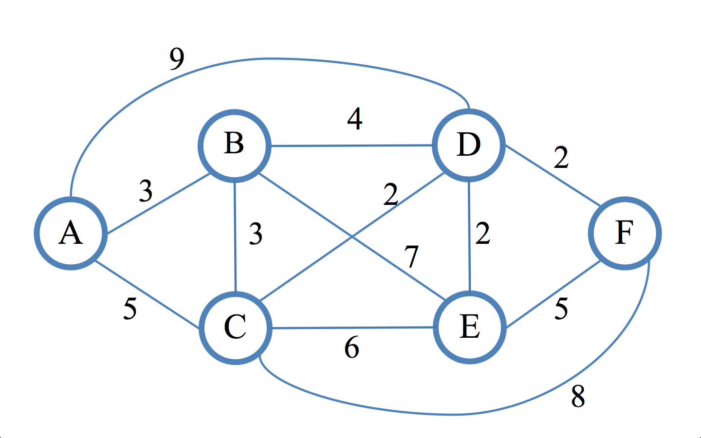
Practice Time
Find the shortest path starting from vertex A

Slide 20
All Pairs Shortest Paths
All Pairs Shortest Paths
Method 1: apply shortestpath algorithm with each of the vertices in V(G) as the source.
Cannot have negative weights
O(n³)
require G has no cycles with a negative length (still O(n³))
Notes:
20

Slide 21
Graph with Negative Weight
G contains negative weight, but no negative cycle
Bellman-Ford Algorithm
Program 6.11 (Page 307)
Notes:
21

Slide 22
All Pair Shortest Paths Dynamic Programming
Method 2: dynamic programming
Define cost adjacency matrix cost[i][j] of graph G
If i = j, cost[i][j] = 0
If <i, j> is not in G, cost[i][j] is set to some sufficiently large number
Define A^{k}[i][j]: the cost of shortest path from i to j
using only those intermediate vertices with an index ≤ k
The shortest path from i to j is A^{n-1}[i][j]
Notes:
22

Slide 23
Algorithm: All Pair Shortest Paths
Algorithm
Define matrix A⁻¹[i][j] = cost[i][j]
For k = 0 to n-1 do
Compute A^{k}[i][j] = min{ A^{k-1}[i][j] , A^{k-1}[i][k]+A^{k-1}[k][j] }
(iteratively compute A⁰, A¹, …, A^{n-1})
6
4
V₀
V1
3 11 2
V₂
A⁰[i][j] = min{A⁻¹[i][j], A⁻¹[i][0]+A⁻¹[0][j]}
A¹[i][j] = min{A⁰[i][j], A⁰[i][1]+A⁰[1][j]}
A²[i][j] = min{A¹[i][j], A¹[i][2]+A¹[2][j]}
cost:
0 | 4 | 11
6 | 0 | 2
3 | 1000 | 0
0 | 4 | 11
6 | 0 | 2
3 | 7 | 0
0 | 4 | 6
6 | 0 | 2
3 | 7 | 0
0 | 4 | 6
5 | 0 | 2
3 | 7 | 0
Notes:
23
0
4
11
6
0
2
3
7
0

Slide 24
Implementation: All Pair Shortest Paths
0 | 4 | 11
6 | 0 | 2
3 | 1000 | 0
void allcosts (int cost[][MAX_VERTICES],
int distance[][MAX_VERTICES], int n)
{
int i, j, k;
for (i=0; i<n; i++)
for (j=0; j<n; j++)
distancee[i][j] = cost[i][j];
for (k=0; k<n; k++)
for (i=0; i<n; i++)
for (j=0; j<n; j++)
if (distance[i][k]+distance[k][j] <
distance[i][j])
distance[i][j] = distance[i][k] +
distance[k][j];
}
6
4
V₀
V₁
3 11 2
V₂
11
0 | 4
 | 0 | 2
3 |  | 0
6
6
5
1000
7

Slide 25
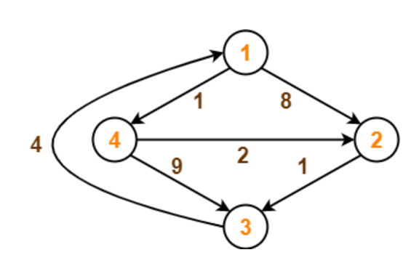
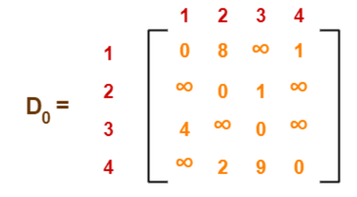
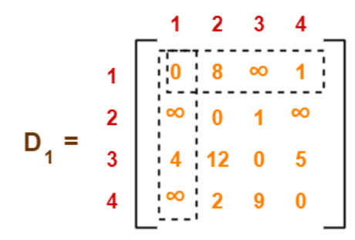
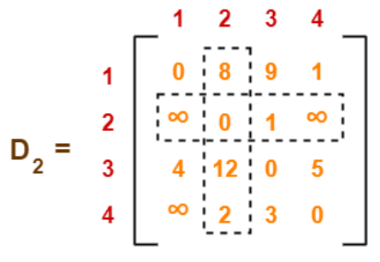
Practice Time

Slide 26
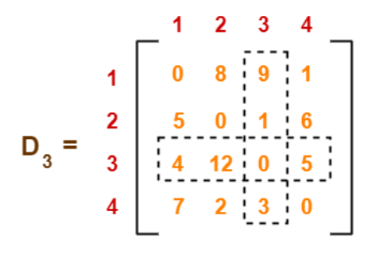
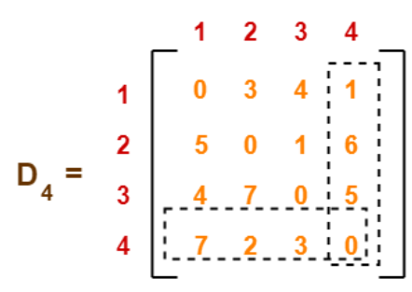
Practice Time

Slide 27
All Pair Shortest Paths Graphs with Negative Cycle
The length of the shortest path from vertex 0 to vertex 2 is -∞
-2
0
1
2
1
1
(a) Directed graph (b) A⁻¹
0, 1, 0, 1, 0, 1, …, 0, 1, 2
Notes:
27

Slide 28
Activity Networks

Slide 29
Activity/Task Ordering
Examples of activity/task ordering
A project can be divided into several subprojects (activities), successful completion of these activities results in the completion of the project.
Find a (best) possible subproject completion sequence
Notes:
29

Slide 30
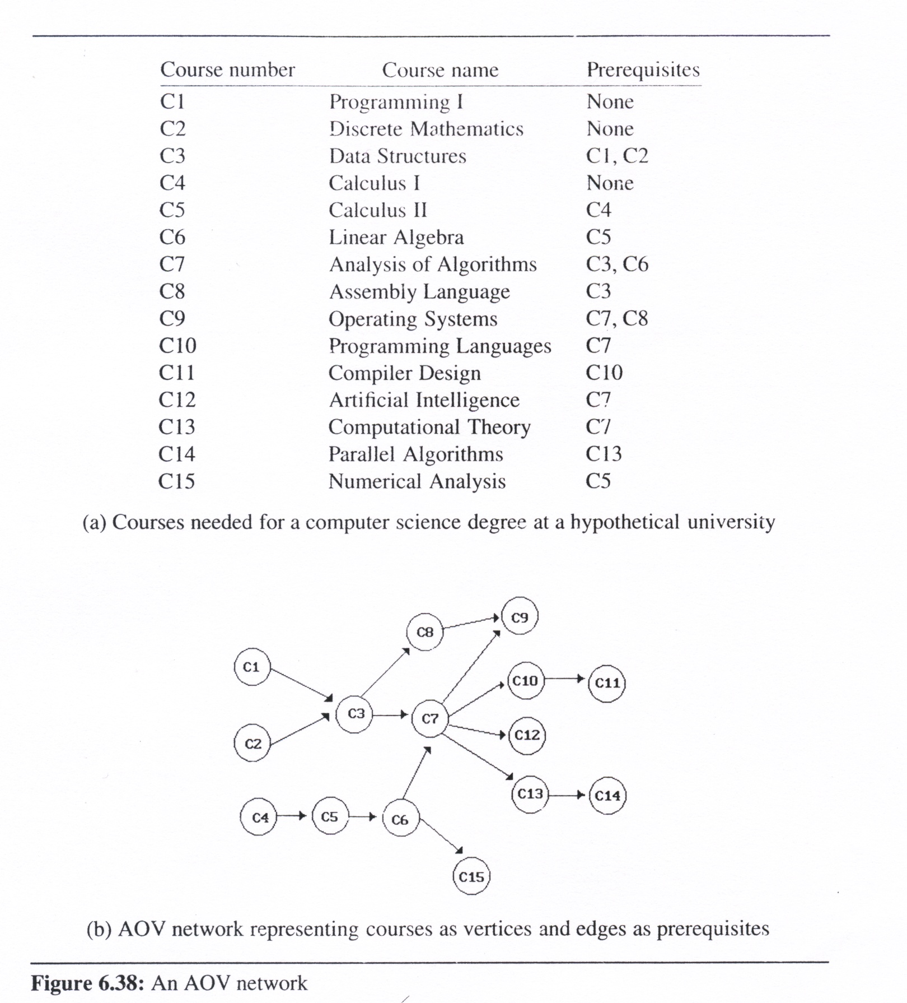
Activity/Task Ordering
Given a list of courses and their pre-requisites, list all different course completion paths
Notes:
30

Slide 31
Topological Ordering
Definition: Topological order
linear ordering of vertices of a graph
for all i, j, if i is a predecessor of j, then i precedes j in the linear ordering
C1, C2, C4, C5, C3, C6, C8, C7,
C10, C13, C12, C14, C15, C11, C9
C4, C5, C2, C1, C6, C3,
C8, C15, C7, C9, C10,
C11, C13, C12, C14
Notes:
31

Slide 32
AOV Network
Activity On Vertex (AOV) Network
a directed graph
the vertices represent tasks or activities
the edges represent precedence relations between tasks
vertex i is a predecessor of vertex j
iff there is a directed path from i to j. j is a successor of i
partial order: a precedence relation which is both transitive ( i, j, k, i  j & j  k → i  k ) and irreflexive ( x, ~(x  x))
acylic graph: a directed graph with no directed cycles
Notes:
32

Slide 33
Topological Sort Algorithm
for (i = 0; i <n; i++) {
if every vertex has a predecessor {
fprintf (stderr, “Network has a cycle. \n “);
exit(1);
}
pick a vertex v that has no predecessors;
output v;
delete v and all edges leading out of v from the network;
}
V₁
V₀
V₂
V₄
Topological order generated:
v₀
v₃
v₂
v₅
v₁
v₄
V₃
V₅
Notes:
33

Slide 34
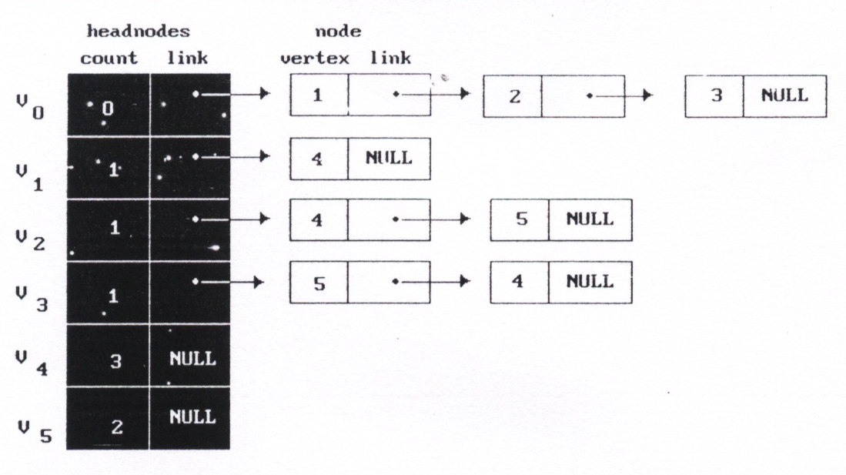
Data Structure for Topological Sort
typedef struct node *node_pointer;
typedef struct node {
int vertex;
node_pointer link;
};
typedef struct {
int count;
node_pointer link;
} hdnodes;
hdnodes graph[MAX_VERTICES];
V₁
V₀
V₂
V₄
decide whether a vertex
has any predecessors
V₃
V₅
the in-degree of that vertex
decide a vertex together
with all its incident edges
Notes:
34

Slide 35
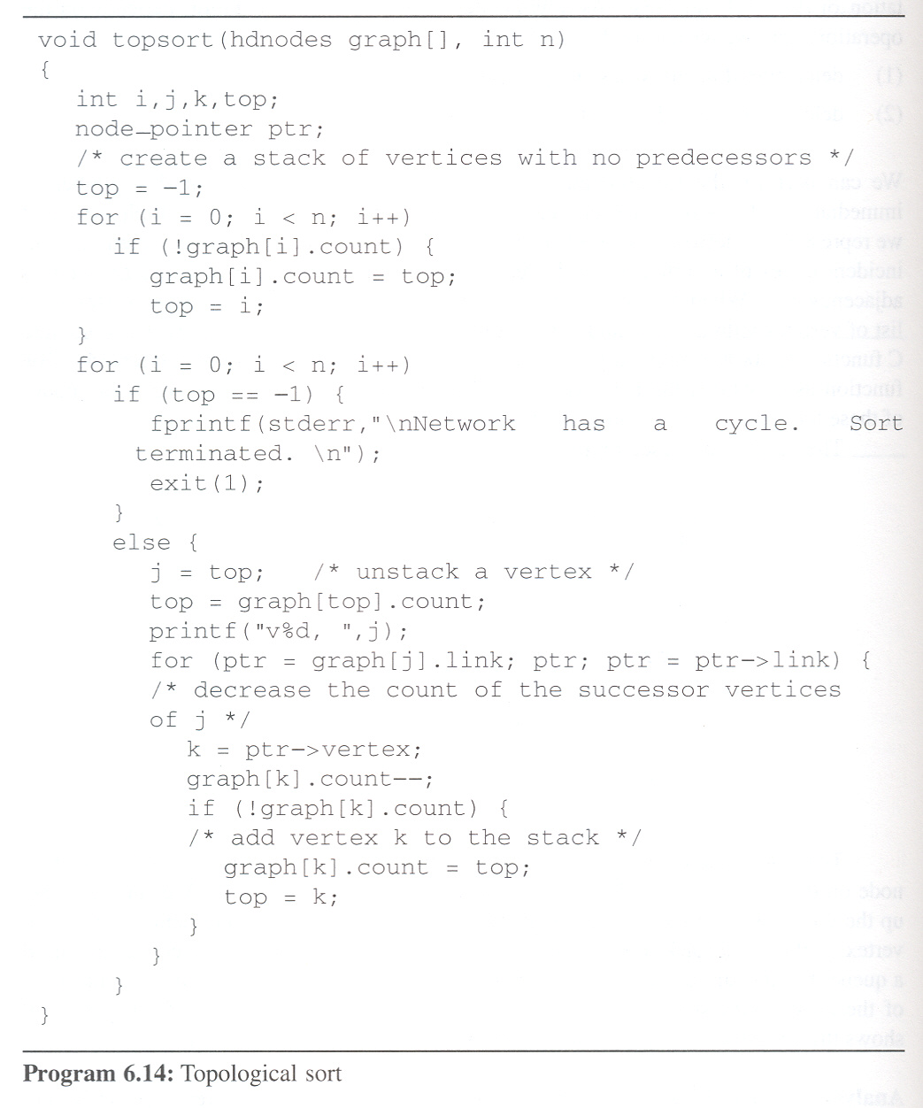
Topological Sort
headnode
V₁
V₀
V₁
V₂
V₃
V₄
V₅
count
-1
-1
0
0
1
0
2
-1
2
1
0
1
0
0
1
1
1
3
1
2
V₀
V₂
V₄
link
node
1
4
4
5
V₃
V₅
2
5
4
ptr
3
top:
-1
-1
-1
0
2
3
2
1
5
1
1
4
j:
3
2
5
1
4
0
k:
1
2
3
5
4
5
4
/* no predecessors
output:
v₀
v₃
v₂
v₅
v₁
v₄
Time complexity: O(n+e)
Notes:
35

Slide 36
Activity on Edge (AOE) Networks
Activity on Edge (AOE) Networks
Examples
What is the least amount of time in which the project may be completed (assuming there are no cycle in the network)
Which activities should be speedup to reduce project length?
Useful for (sub-)project performance evaluation
Notes:
36

Slide 37
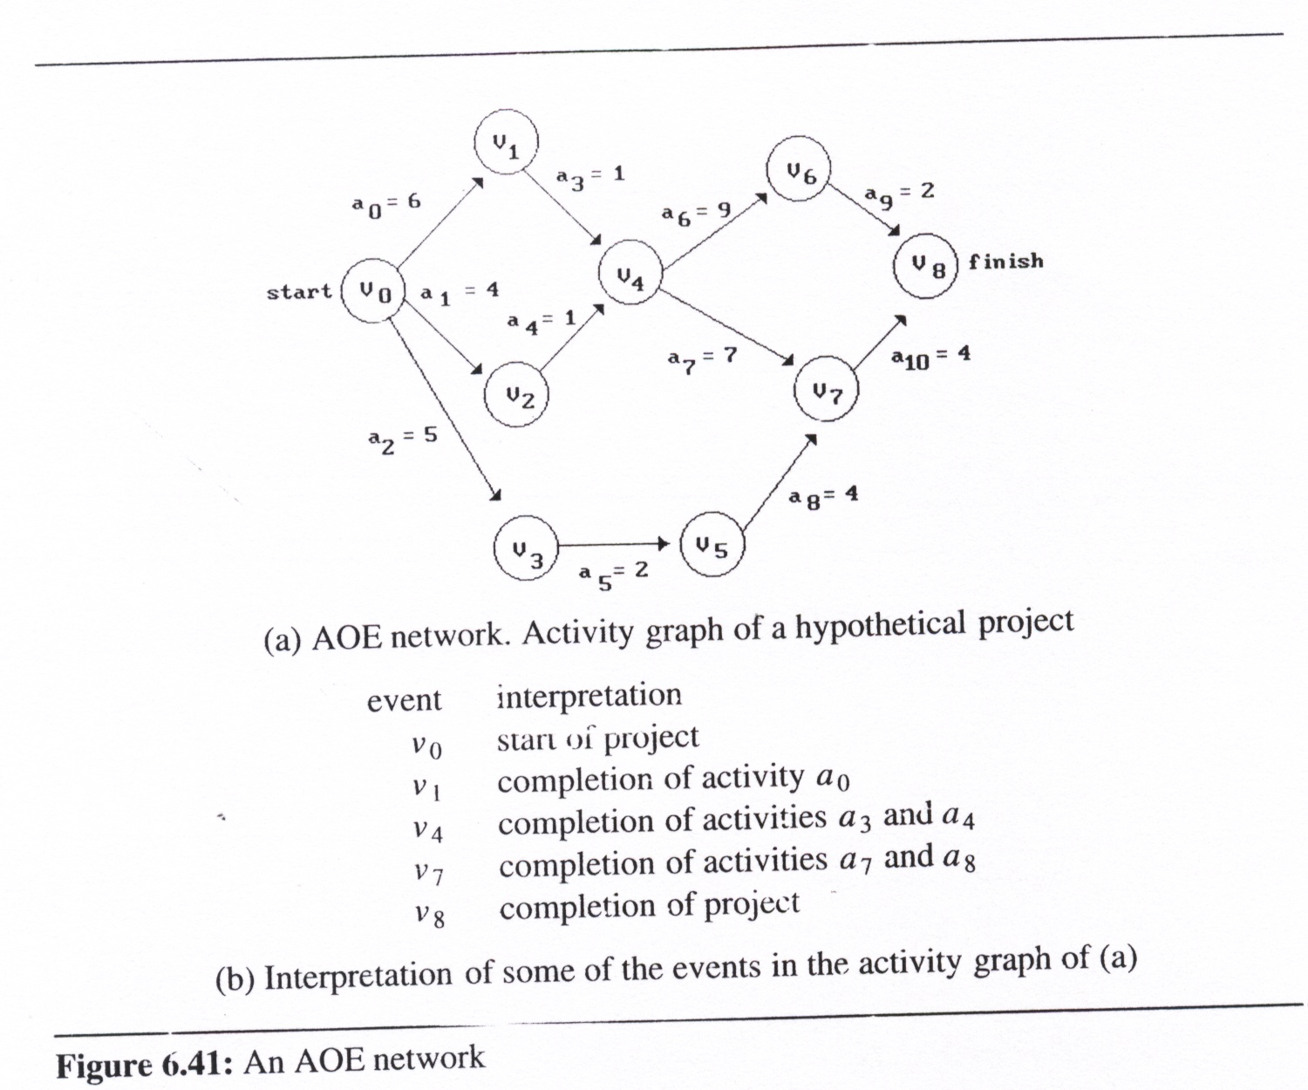
AOE Network Interpretation
directed edge: tasks or activities
vertex: events which signal the completion of certain activities
number: associated with each edge
the time required to perform the activity
Notes:
37

Slide 38
Critical Paths on AOE Network
Application of AOE Network
Critical path
a path that has the longest length
minimum time
required to complete
the project
v₀, v₁, v₄, v₆, v₈ or v₀, v₁, v₄, v₇, v₈ (18)
Notes:
38

Slide 39
Critical Path Analysis
Why critical-path analysis?
To reduce project finish time
identify critical activities so that resource may be concentrated on these activities
Determining Critical Paths
Delete all noncritical activities
Generate all the paths from the start to finish vertex
Notes:
39

Slide 40
Critical Activity (edge)
early(i): earliest occurrence time of activity i (edge)
early(5)=5, early(6) = early(7)=7
late(i): latest occurrence time of activity i (edge)
late(5)=18-4-4-2=8, late(7)=18-4-7=7
late(i)-early(i)
measure of criticality
Critical activity
couldn’t be delayed: early(i) = late(i)
(ex. early(7)=late(7))
Notes:
40

Slide 41
Finding Critical Activity
earliest[j]:
earliest event occurrence time for event j (vertex)
length of the longest path from v₀ to v_{j} (Ex. 7 for v₄)
latest[j]:
latest event occurrence time for event j
If activity a_{i} is represented by edge <k, j>
early(i) = earliest[k]
late(i) = latest[j] - duration of a_{i}
earliest
latest
a_{i}
v_{k}
v_{j}
Notes:
41

Slide 42
Calculating earliest(j)
Calculating earliest time of events
start with earliest[0] = 0
the remaining events start times:
P(j): the set of immediate predecessors of j
earliest[j] should be computed in topological sorting order
Modify topsort with the following:
v_{i1}
.
.
.
.
+ duration
+ duration
v_{i2}
v_{j}
max
v_{in}
if (earliest[k] < earliest[j] + ptr->duration)
earliest[k] = earliest[j] + ptr->duration;
v_{j1}
v_{j2}
v_{k}
Notes:
42

Slide 43
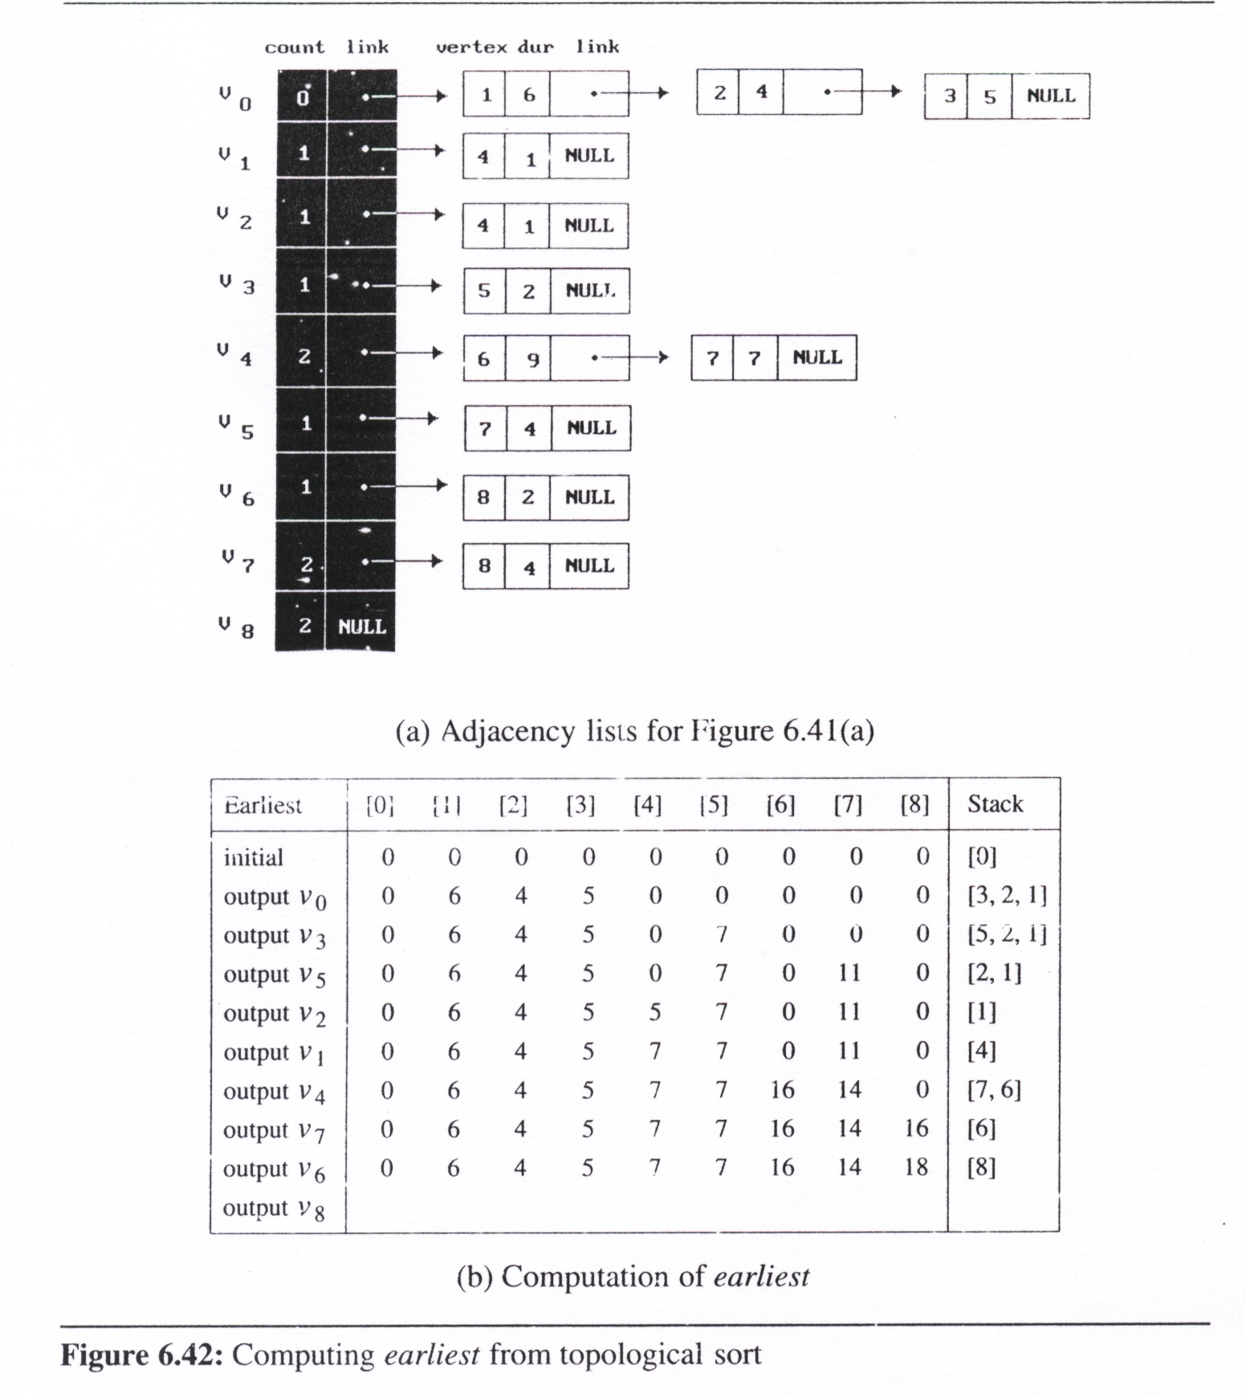
earliest(j) function
for (ptr=graph[j].link;ptr;ptr=ptr->link){ k=ptr->vertex; graph[k].count--; if(!graph[k].count){ graph[k].count=top; top=k;} if(earliest[k] < earliest[j] + ptr->duration) earliest[k] = earliest[j] + ptr->duration;
}
Notes:
43

Slide 44
earliest(j) function
for (ptr=graph[j].link;ptr;ptr=ptr->link){ k=ptr->vertex; graph[k].count--; if(!graph[k].count){ graph[k].count=top; top=k;} if(earliest[k] < earliest[j] + ptr->duration) earliest[k] = earliest[j] + ptr->duration;
}
Notes:
44

Slide 45
Calculating latest [j]
Calculating latest time of events
start with latest[n-1] = earliest[n-1]
the remaining latest[j] can be computed as
S(j): the set of vertices adjacent from vertex j
latest[j] should be computed in inverse topological sorting order
Use inverse adjacency list
Modify topsort with the following:
v_{i1}
v_{j}
v_{i2}
.
.
.
min
- duration
v_{in}
v_{j1}
if (latest[k] > latest[j] - ptr->duration)
latest[k] = latest[j] - ptr->duration;
.
.
.
v_{k}
v_{j9}
Notes:
45

Slide 46
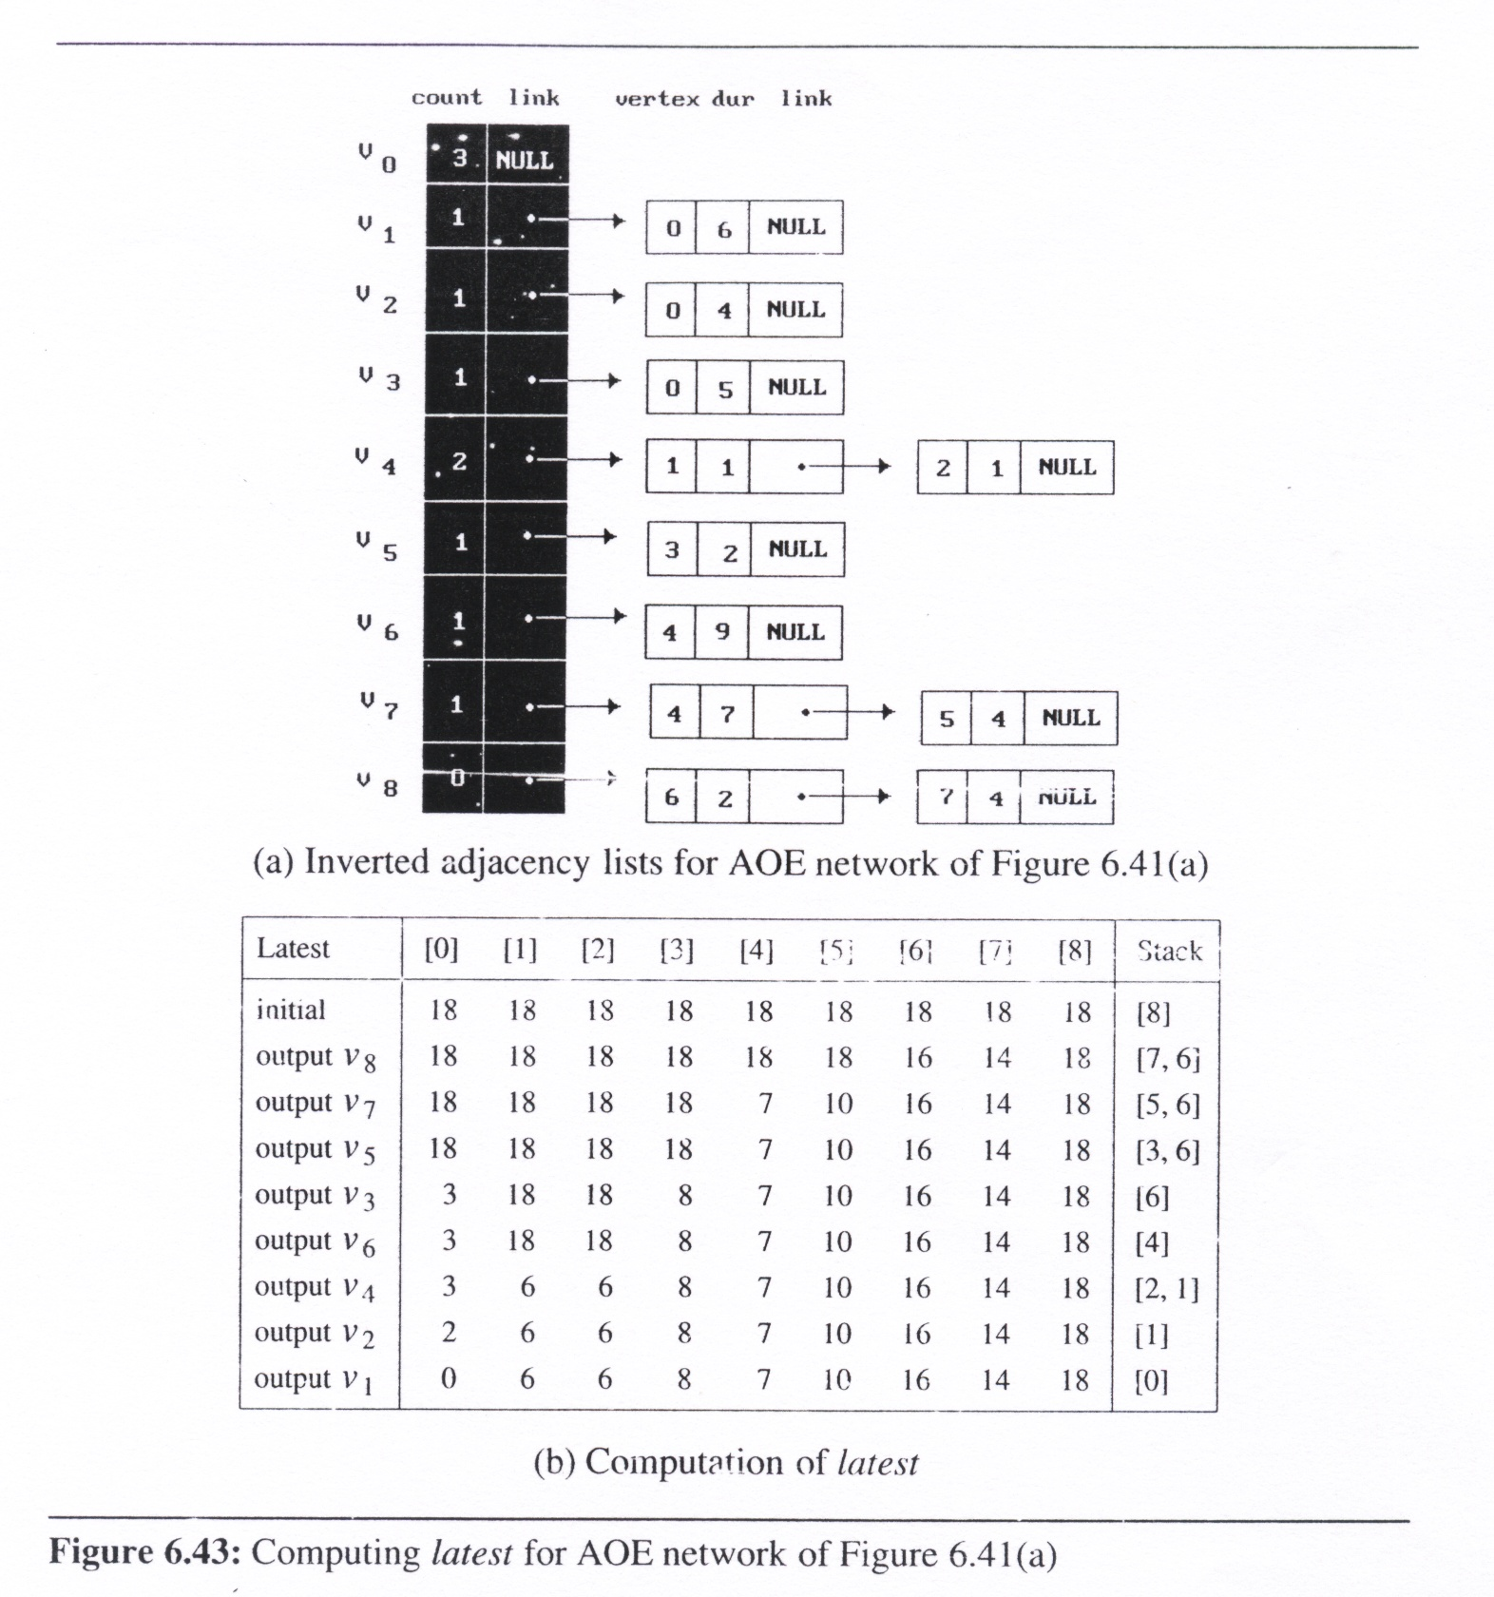
latest (j) function
for (ptr=graph[j].link;ptr; ptr=ptr->link){ k=ptr->vertex; graph[k].count--; if(!graph[k].count){
graph[k].count=top; top=k;} if(latest[k]> latest[j]-ptr->duration)
latest[k] = latest[j]-ptr->duration;
}
Notes:
46

Slide 47
latest (j) function
for (ptr=graph[j].link;ptr; ptr=ptr->link){ k=ptr->vertex; graph[k].count--; if(!graph[k].count){
graph[k].count=top; top=k;} if(latest[k]> latest[j]-ptr->duration)
latest[k] = latest[j]-ptr->duration;
}
8
Notes:
47

Slide 48
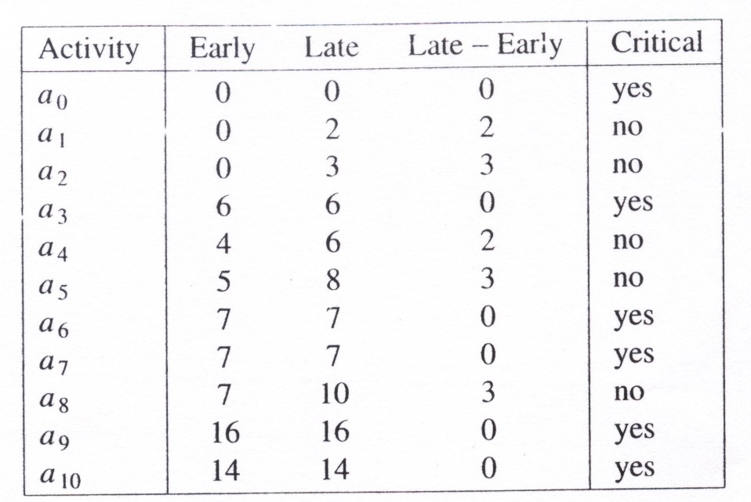
Deleting Non-Critical Activities
a_{i}
early(i) = earliest[k]
late(i) = latest[j] - duration of activity a_{i}
Critical activities
early[a_{i}] = late[a_{i}]
v_{k}
v_{j}
Notes:
48

Slide 49
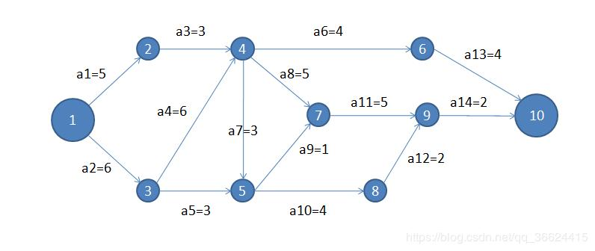
Practice Time
Find the critical path of the AOE network

Slide 50
Topological Sort Limitations
Vertices may not be reachable from the start vertex
earliest[i] = 0
a₄
V₃
V₄
a₅
V₁
a₆
a₀
a₂
V₀
V₅
a₁
a₃
V₂
Notes:
50

Slide 51
Summary

Slide 52
Graphs Summary
Graph Definitions and Abstract Data Type
Undirected Graph, Directed Graph, Networks
Graph Representations
Adjacency matrix
Adjacency list, Inverse adjacency list
Adjacency multilists
Elementary Graph Operations
DFS, BFS
Graph Applications
Minimum Spanning Trees
Kruskal, Prim, Sollin Algorithm
Shortest Paths
Dijkstra’s Algorithm
Bellman-Ford Algorithm
All-pair shortest path Algorithm
Activity Networks
AOV Networks
AOE Networks
Critical Path Analysis

